Slide 1
International study centre
An Introduction to object-orientation and software design
Name : John Alamina
Email : john.alamina@hud.ac.uk

Slide 2
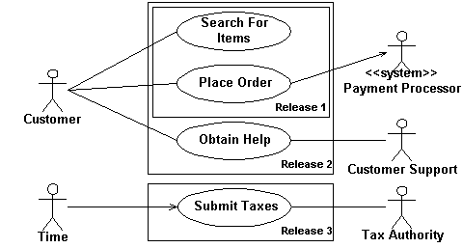
Use Case Diagrams
A UML use-case diagram is used to provide an overview of all or part of the usage requirements in the form of a model.
It shows the relationship among actors and use cases within a system.
An actor is a person, organization, local processes ( e.g. system clock), or external system that plays a role in one or more interactions with your system.
Actors are drawn as stick figures

Slide 3
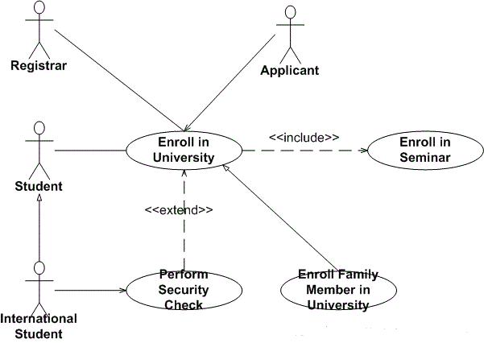
Use Case Diagrams – Relationship Guidelines
Solid lines are used when an actor supplies or receives information or initiates the use case
Used case description is represented in an oval.
Include is used to attach a smaller use case to a base use case, this makes them more manageable.
Extend is used when an optional use case is needed under certain conditions.
Include and extend are represented with dashed arrows.

Slide 4
Use Case Diagram – Exercise
Create a use case diagram on www.draw.io that represents students and teacher’s interaction with the Software Design Module Brightspace Page.
It should show the actors.
Think of a minimum of four use cases that involves at least one of the actors and include these in your diagram.
Think of one use case that involves two of the actors and represent this as well.

Slide 5
Activity Diagram
There are several subsets of diagrams under the UML such as structure diagrams, interaction diagrams and behavior diagrams.
Activity diagrams as well as use case and state machine diagrams are considered as behavior diagram.
Activity diagrams are the object-oriented equivalent of flowcharts
A major benefit of the activity diagram is that it helps to demonstrate the logic of an algorithm.

Slide 6
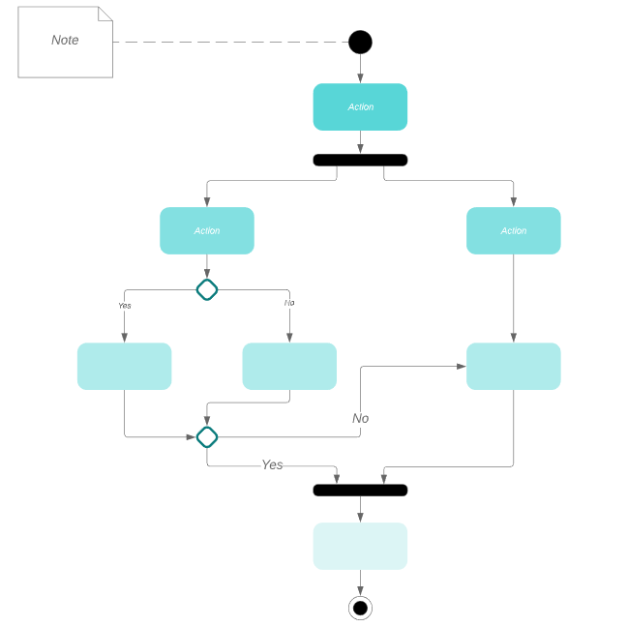
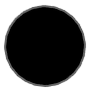
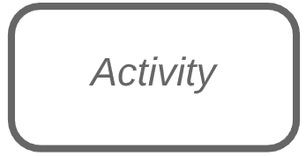

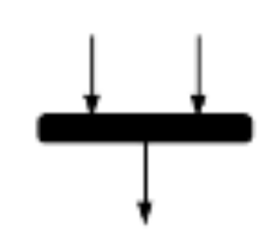



Activity diagram symbols
Symbol | Name | Description
 | Start | Represents the beginning of a process.
 | Activity | Represents the activity that makes up a modelled process
 | Connector | Shows the direction of flow of the activity.
 | Joint | Combines two concurrent activities and re-introduces them to a flow for single activity.
 | Fork | Splits a single activity flow into two concurrent activities.
 | Decision | Represents a decision with at least two paths branching out with condition texts.
 | End | Marks the end of an activity and the completion of all flows of a process.

Slide 7
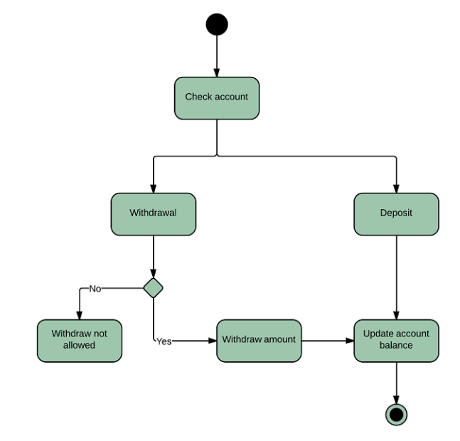
Activity diagram example and task.
Example:
Task:
Create an activity diagram for a POS payment system.
It should accept contactless payment if total amount due is less than £30 else card should be inserted to the machine.
If card is inserted, it should check for the correctness of the PIN.
At the end of a successful transaction, it should ask if customer needs a receipt and respond appropriately.

Slide 8
Structured Programming
Structured programming is aimed at improving the clarity, quality and development time of a computer program.
It makes extensive use of the structured control flow constructs such as selection (if/then/else statements), repetition (while and for loops), block structures (sequence) and sub routines.
This makes codes easier to follow when compared with simple tests and jumps such as go to statements.

Slide 9
Concepts in Structured Programming – Sequence.
Everyday life example:
Sequence: Execute a list of statements in order.
Example: Baking Bread
Add flour.
Add salt.
Add yeast.
Mix.
Add water.
Knead.
Let rise.
Bake.
Programming example:
Sequence: Lines or blocks of code are written and executed in sequential order.
Example:
x = 5
y = 11
z = x + y
WriteLine(z)

Slide 10
Concepts in Structured Programming – Repetition.
Everyday life example:
Repetition: Repeat a block of statements while a condition is true.
Example: Washing dishes
Stack dishes by sink.
Fill sink with hot soapy water.
While moreDishes
Get dish from counter,
Wash dish,
Put dish in drain rack.
End While
Wipe off counter.
Rinse out sink.
Programming example:
Repetition: Repeat a block of code (Action) while a condition is true. There is no limit to the number of times that the block can be executed.
Example:
x = 2
While x < 100
WriteLine(x)
x = x * x
End

Slide 11
Concepts in Structured Programming – Selection.
Everyday life example:
Selection: Choose at most one action from several alternative conditions.
Example: Sorting mails
Get mail from mailbox.
Put mail on table.
While moreMailToSort
Get piece of mail from table.
If pieceIsPersonal Then
Read it.
ElseIf pieceIsMagazine Then
Put in magazine rack.
ElseIf pieceIsBill Then
Pay it,
ElseIf pieceIsJunkMail Then
Throw in wastebasket.
End If
End While
Programming example:
Selection: Repeat a block of code (Action) while a condition is true. There is no limit to the number of times that the block can be executed.
Example:
If n = 1 Then
WriteLine("One")
ElseIf n = 2 Then
WriteLine("Two")
ElseIf n = 3 Then
WriteLine("Three")
Else
WriteLine("Many")
End If

Slide 12
Any Questions?

